Slide 3
Pamplin College Of Business Rankings
US News and World Report
27th among public business colleges
43rd among all business colleges
HTM 2nd in US, 6th in world
FIN 5th in US
ACIS 17th in US
28th Employer Survey – Bloomberg Business Week

Slide 4
Pamplin College Of Business
4,500+ undergrad students
17 countries represented
3.99 average high school GPA
1255 average SAT scores
88% of students have job at graduation
$59,000 average starting salary

Slide 6
Majors
Accounting and Information Systems
Business Information Technology
Finance
Hospitality and Tourism Management
Management
Marketing
Real Estate

Slide 7
Minors
Entrepreneurship and New Venture Growth
International Business
Professional Sales
Digital Marekting Strategy
Business Leadership

Slide 10
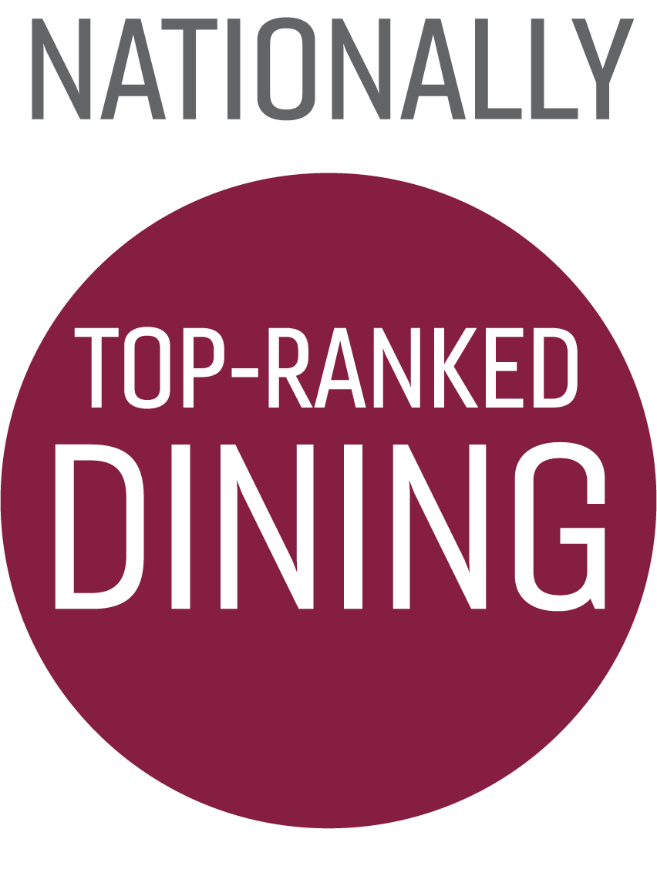

Slide 14
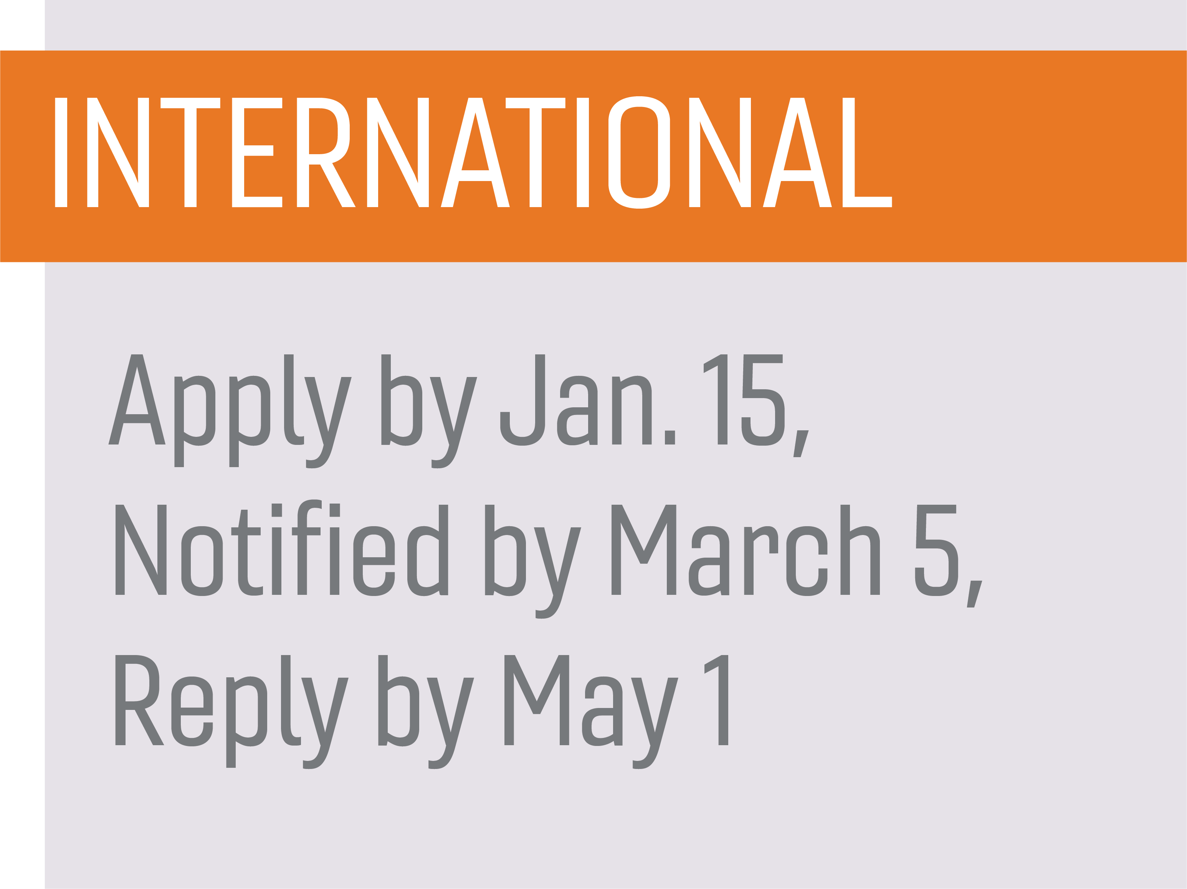
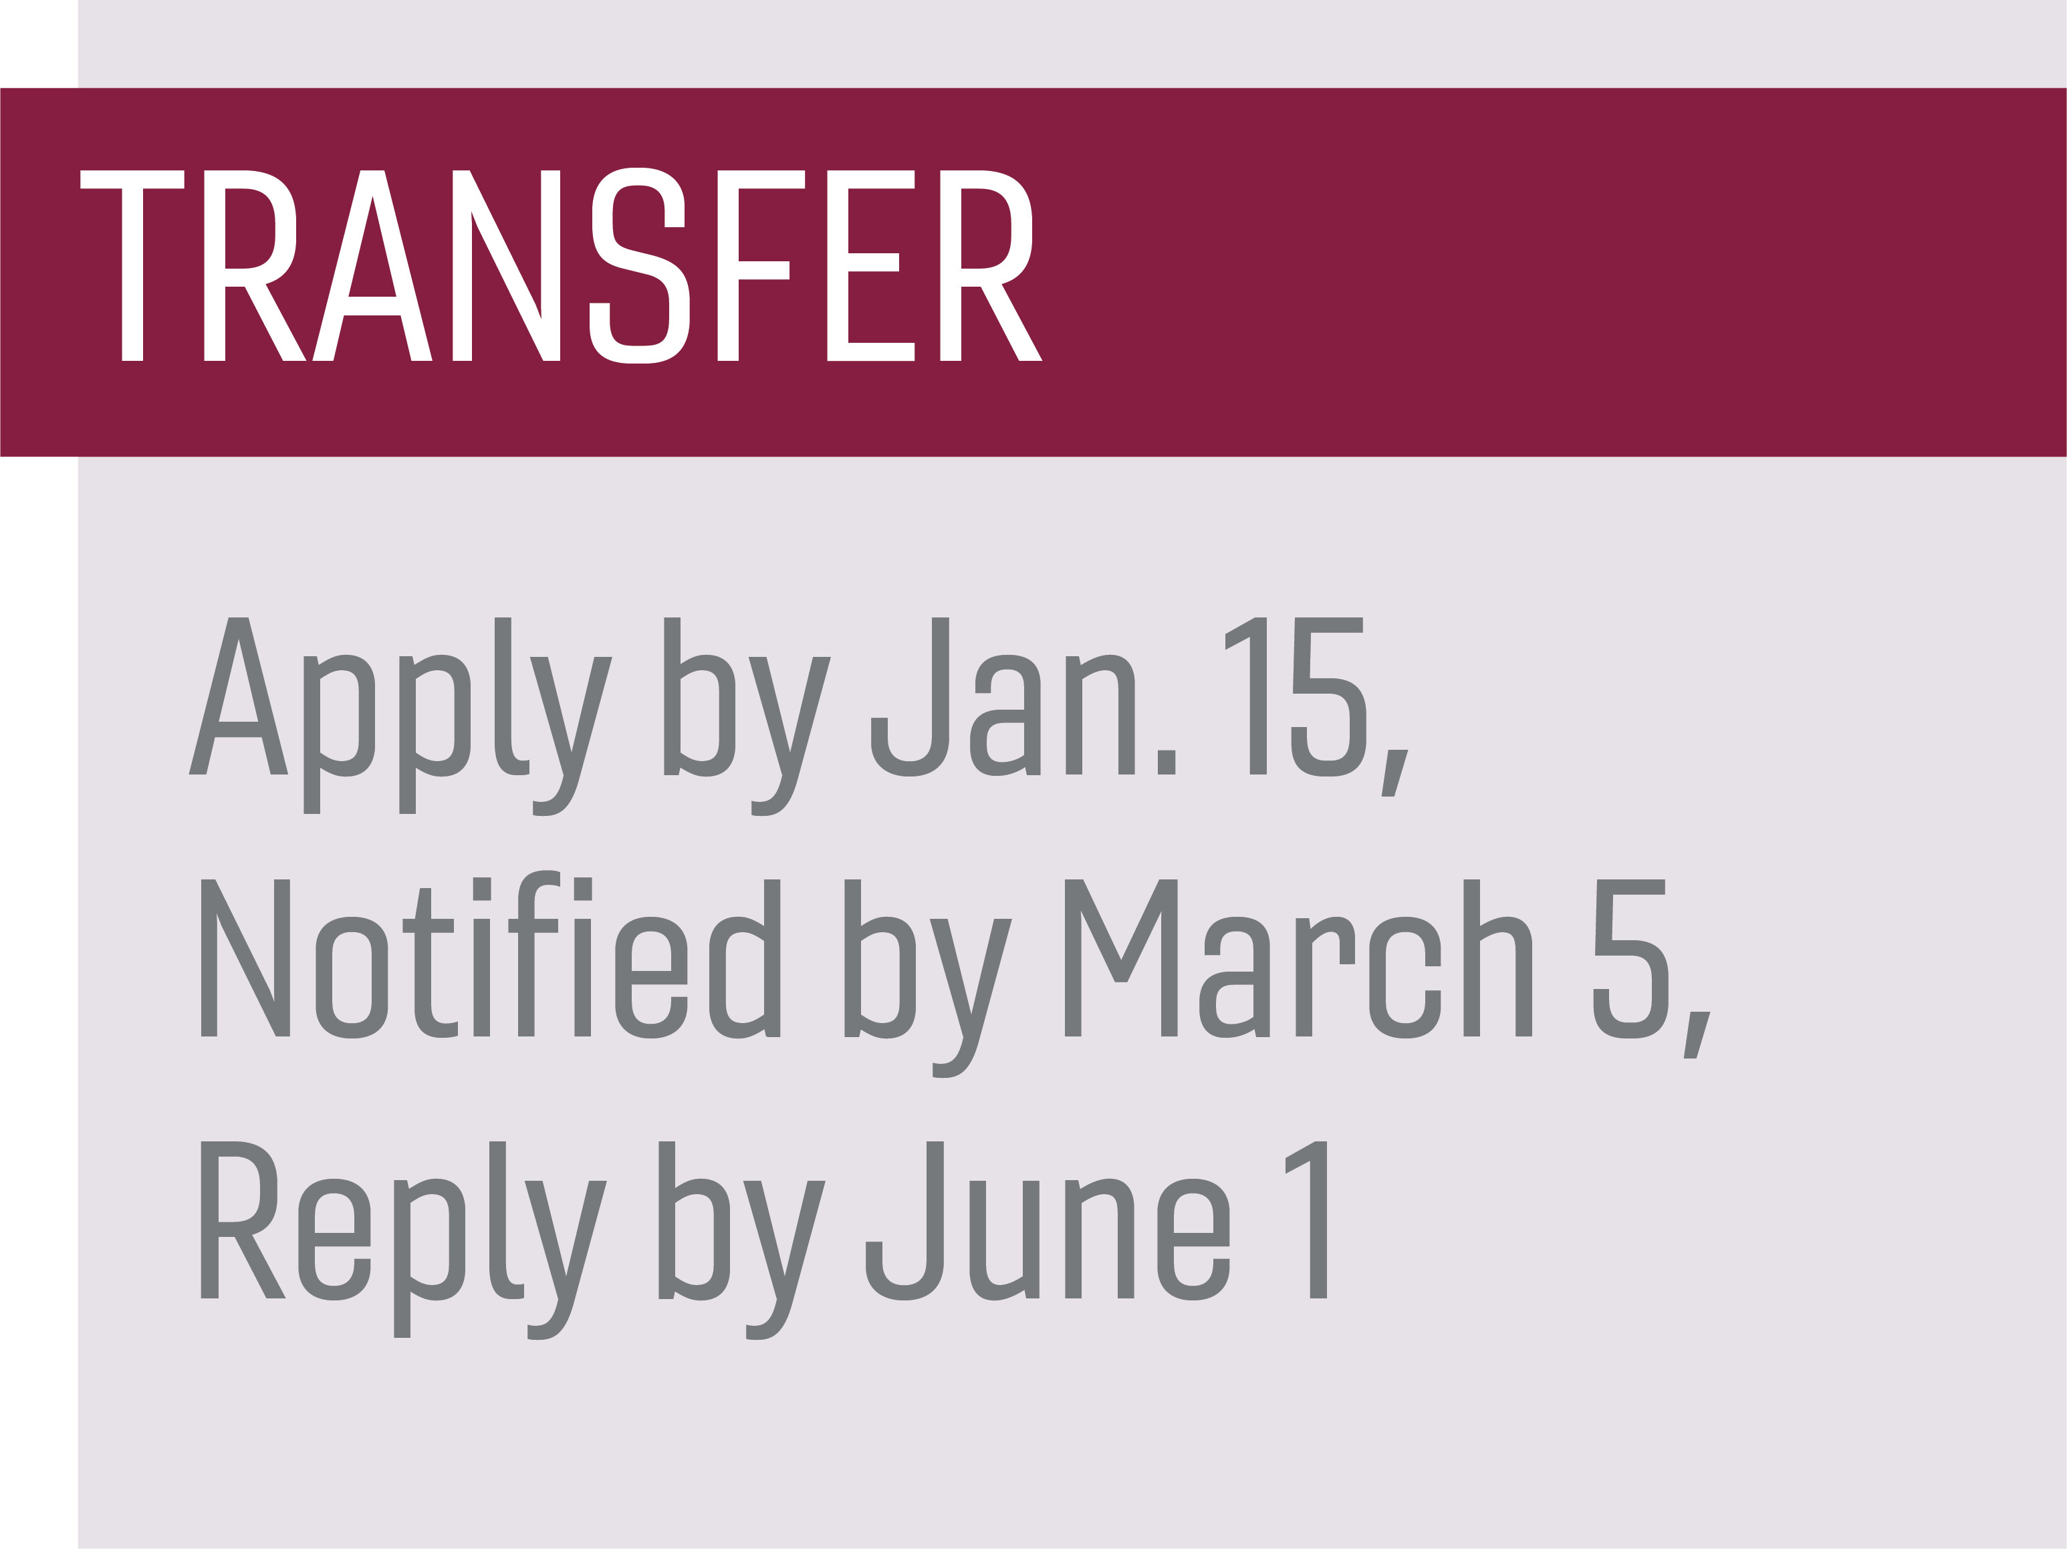

Slide 16
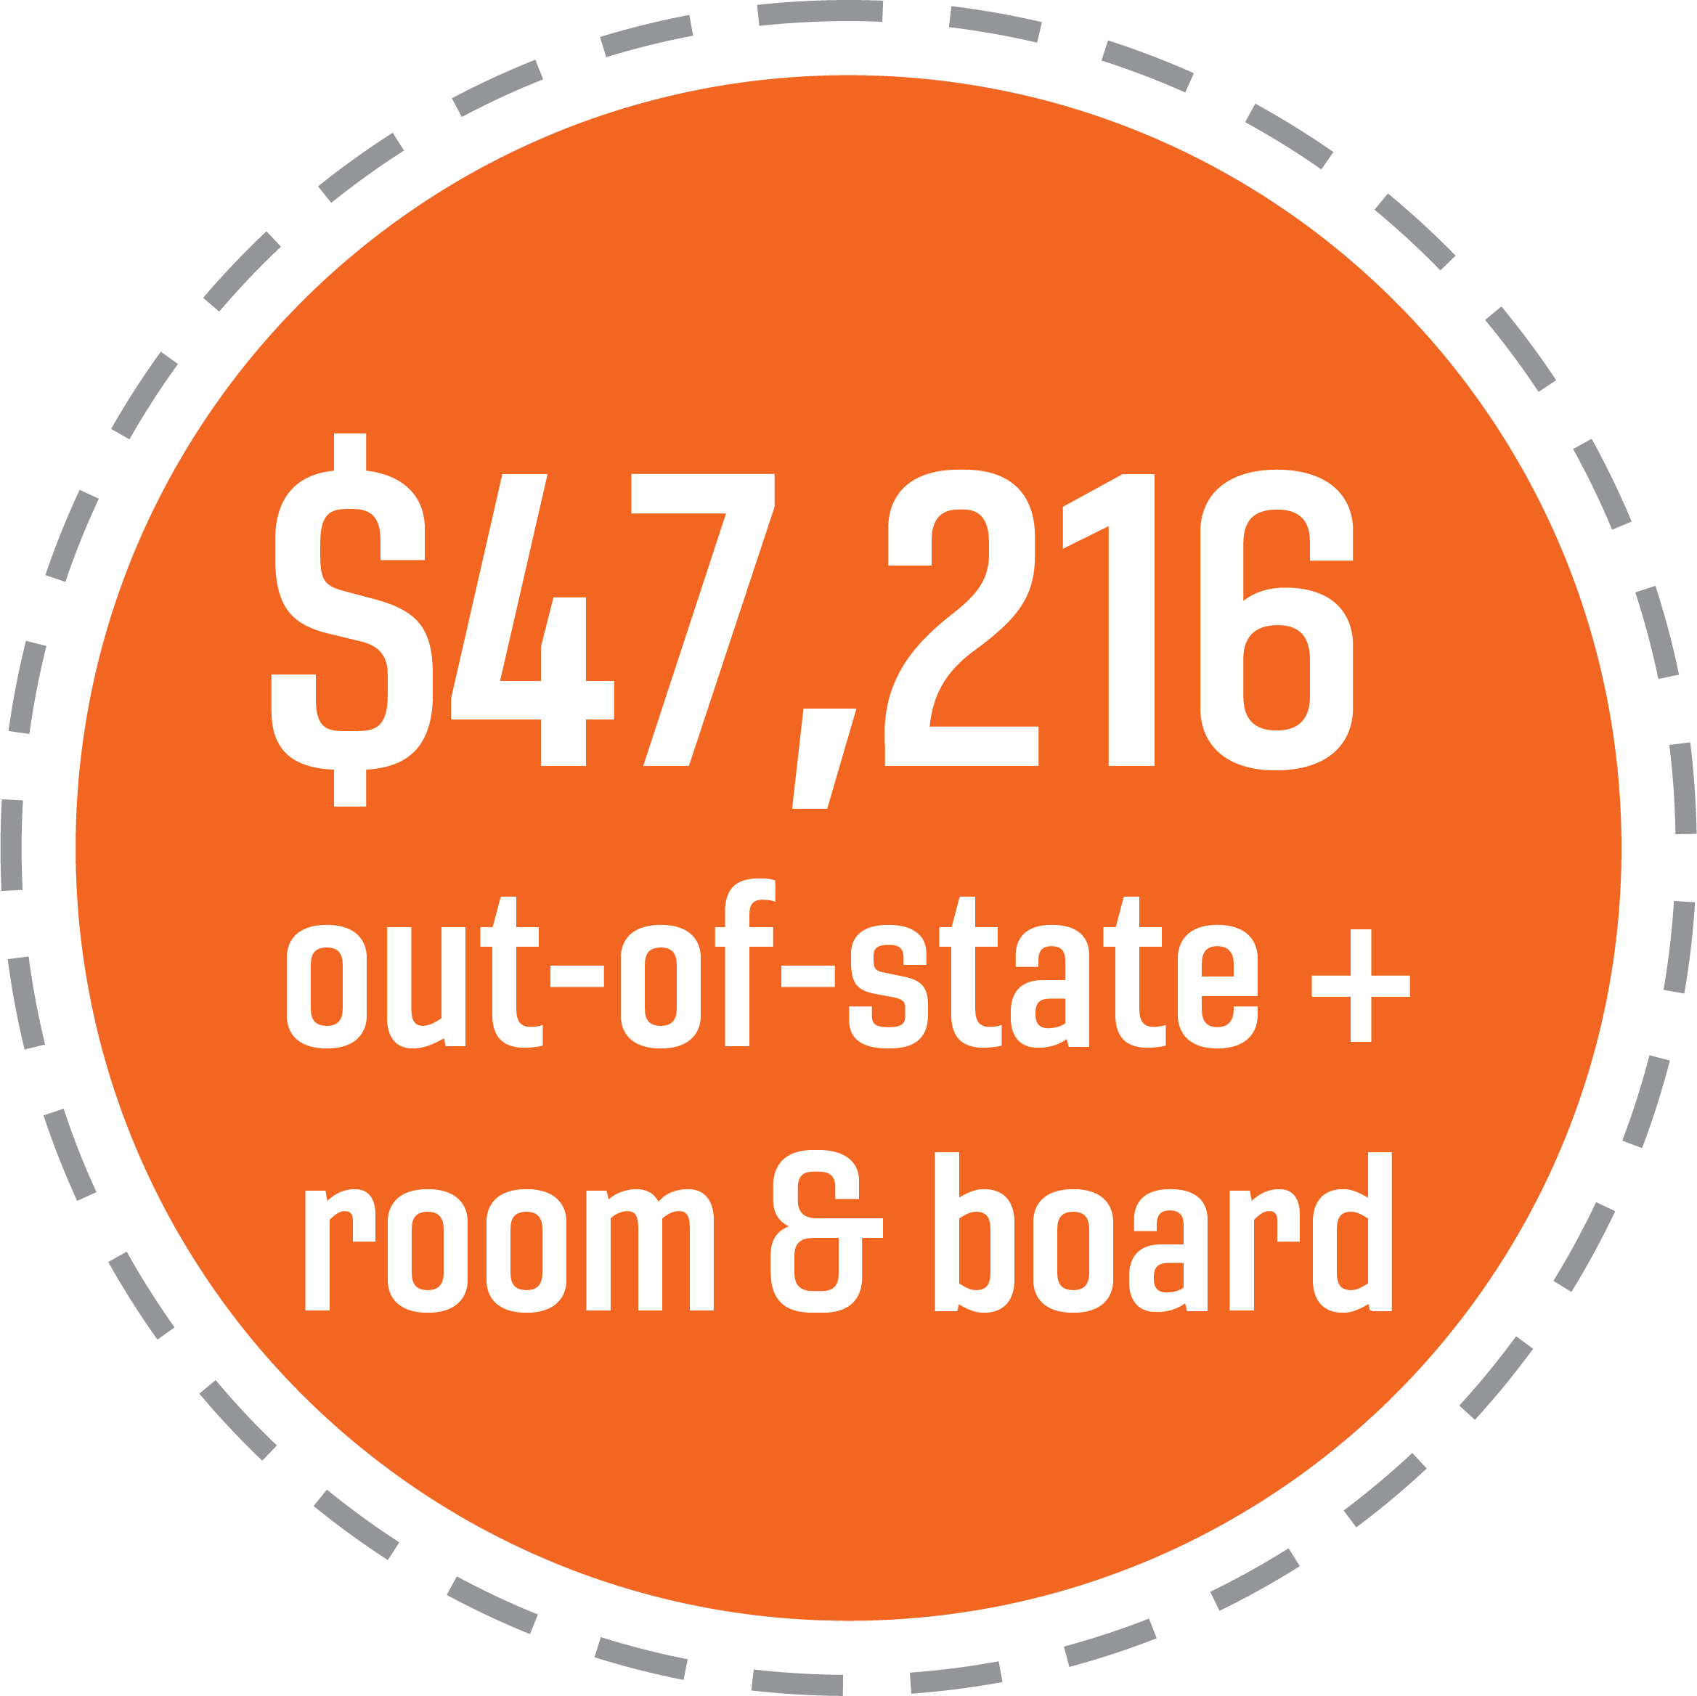
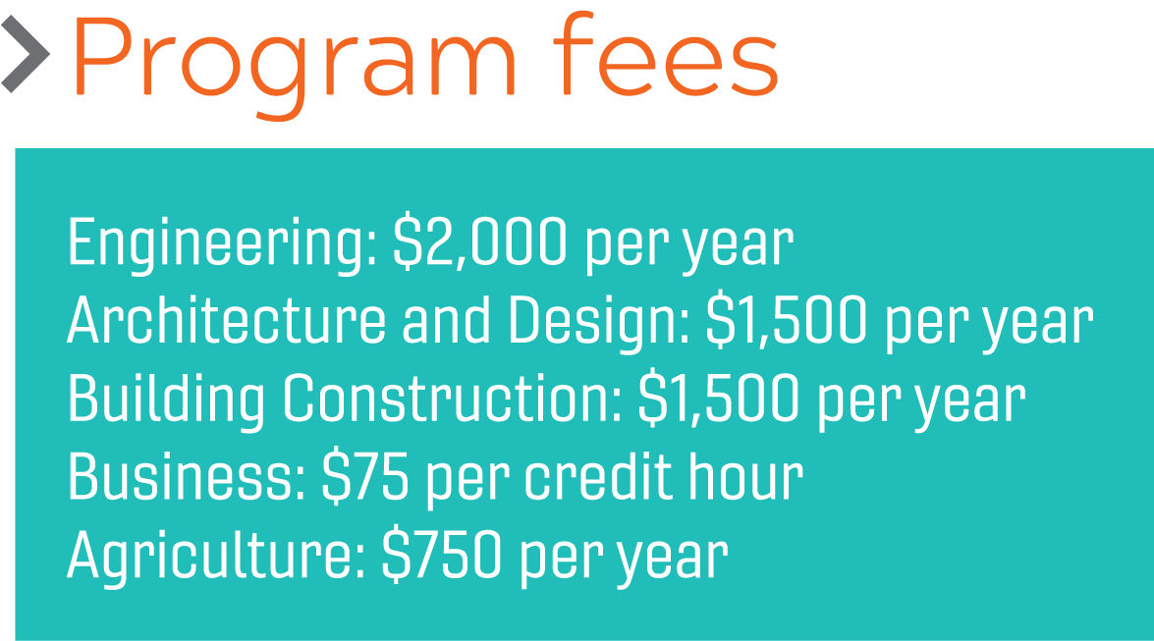
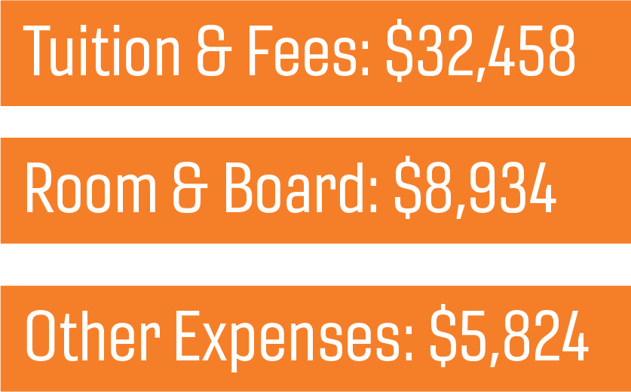

Slide 17
Summer Business Study
Short-term Camp in July
2-3 weeks intensive American business and culture study
Includes business visits to incubators/companies
American business and culture
Business communications and etiquette
Professionalism in the workplace
Business Leadership

Slide 18
Dr. Clevenger jcleveng@vt.edu
Ms. McCorkle eafrica@vt.edu
http://whypick.pamplin.vt.edu
http://pampl.in/ContactSurvey

