Slide 1
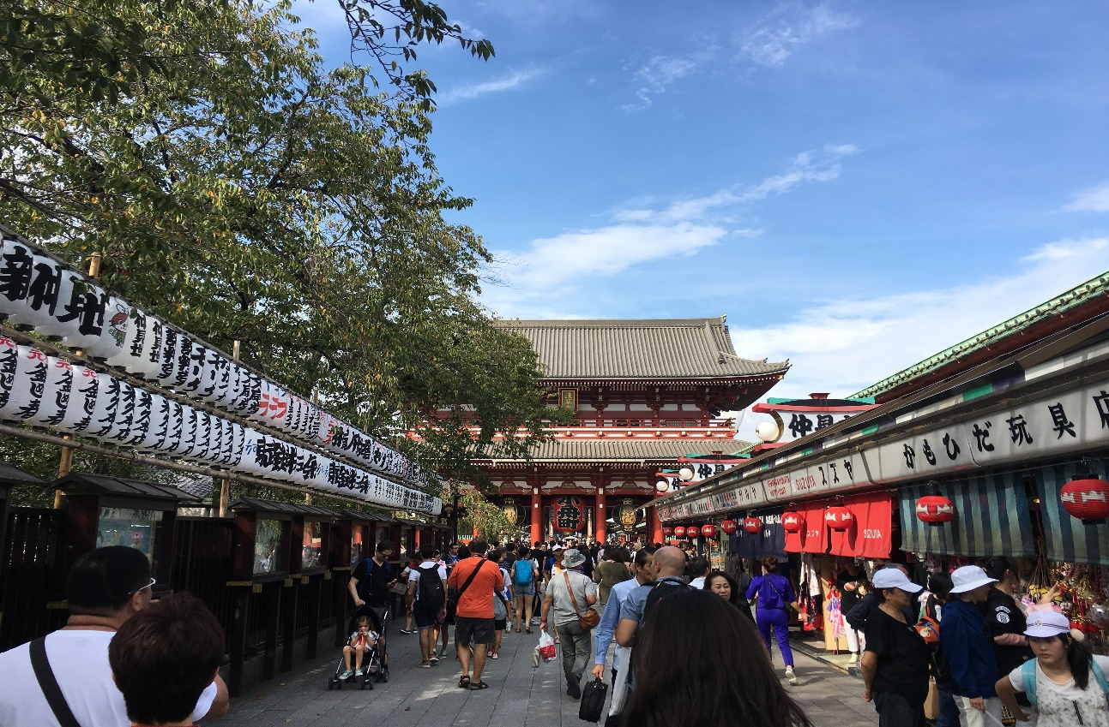
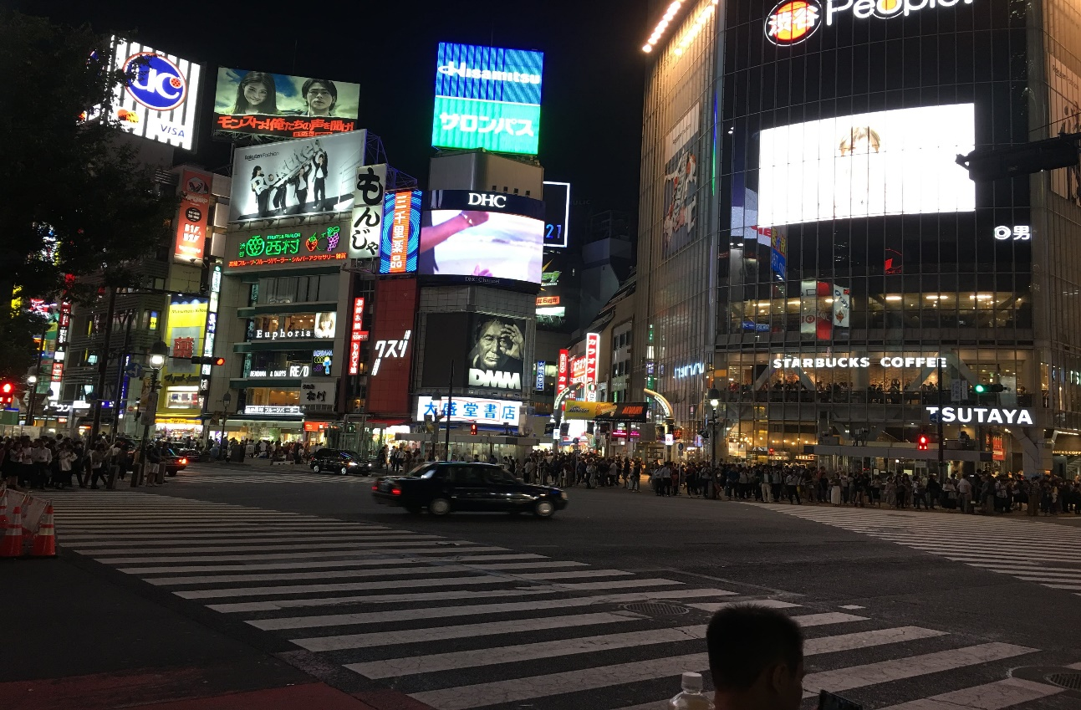
Virginia Tech- Pamplin College of Business
Tokyo-Osaka-Ho Chi Minh City-Seoul-Mumbai-Manchester-London-Beijing-Shanghai-Shenzhen-Virtual locations
Summer Internships

Slide 2
Who are We?

Slide 3
Program Schedule – Tokyo
We offer full internship programs with high quality accommodation for the duration of the program and placement-Only Program for 30, 60, 90 days any time throughout the year.
You can decide a start date that is convenient for you.
*Other programs in Osaka, Ho Chi Minh City, Seoul, Mumbai, Manchester, London, Beijing, Shanghai and Shenzhen
have similar schedules and program details

Slide 4
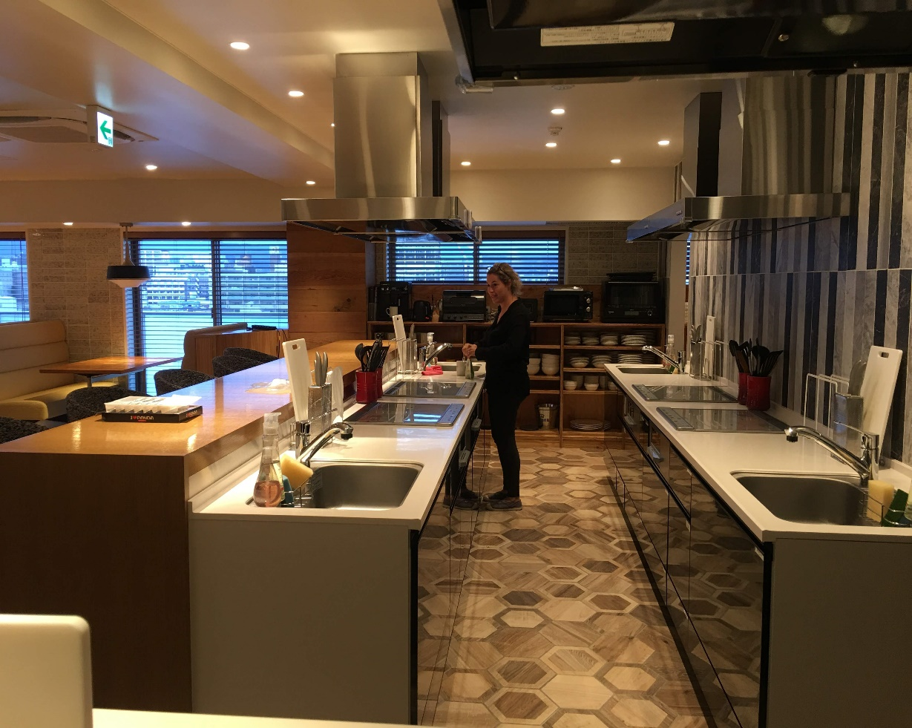
Program Inclusions – Tokyo
High-quality, centrally located accommodation with private bathrooms and mini-kitchens, large central kitchen
CareerBridge, our Professional Development Hub, which contains 12 professional development courses
Welcome Pack on arrival (SIM & Travel card included)
Airport Pickup and Accommodation Drop-off
Orientation Weekend, including city tour
First Day Company Drop-off
Pre-Departure Assistance from our local teams
Business, Cultural, and Community Outreach Events
24/7 support from on the ground staff
Exclusive Alumni Network and LinkedIn groups
*Sample of the actual accommodation

Slide 5
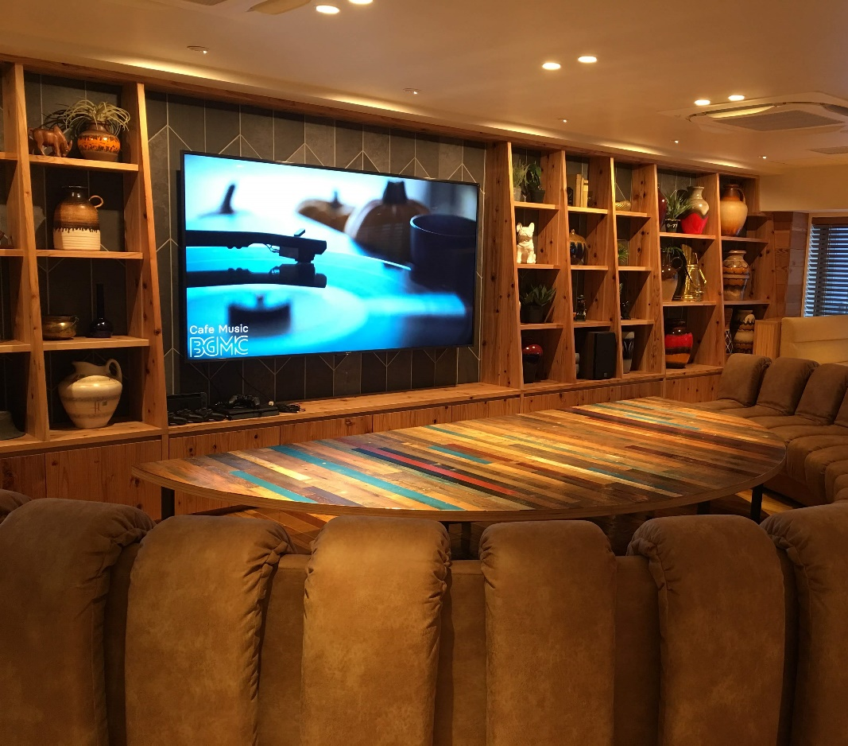
Eligibility Requirements
Hold a valid passport
Up-to-date and polished resume
Eligible for specific visa (varies for each location)
Completed application form
Must meet with Dr. Jennifer Clevenger before applying
*Sample of the actual accommodation

Slide 6
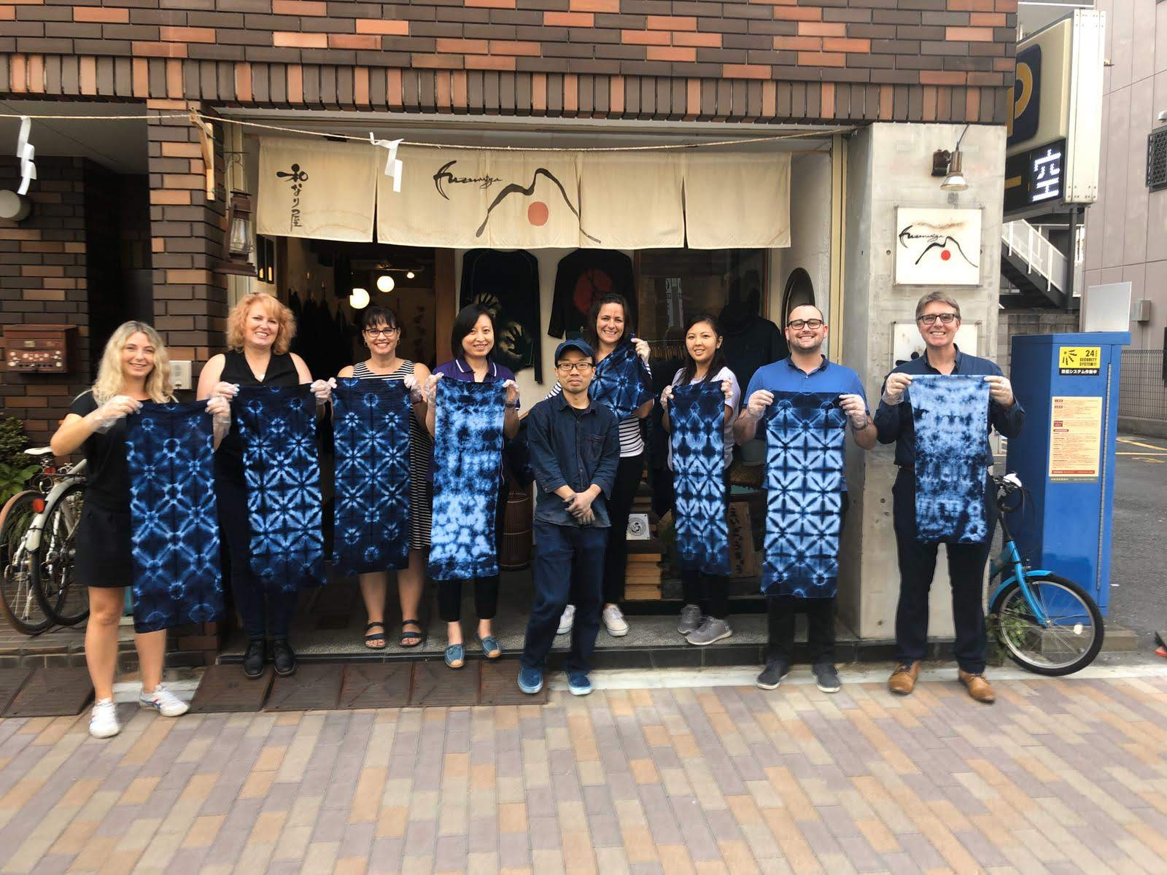
Application process
Must meet with Dr. Jennifer Clevenger to discuss application process
Choose your program location
Choose your career field
Decide your learning objective
Apply for your global internship
*sample of actual culture event (indigo dyeing)

Slide 7
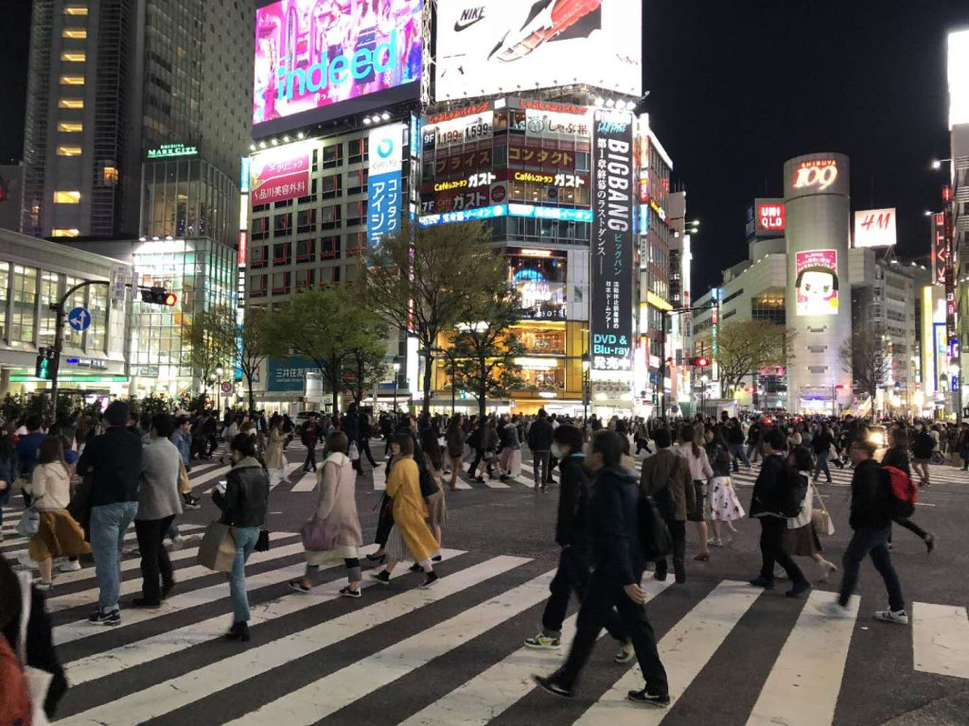
Tokyo, Japan
Tokyo is the largest metropolitan city in the world, with a total of more than 38 million residents.
Cost of living – about 40% less than New York, with rent prices being over 60% cheaper.
Tokyo is home to some of the most unique areas in all of Asia. Strut your stuff in stylish Harajuku, an area known for its stylish fashion boutiques, or pick up some rare anime and collectibles in Akihabara Electric Town.
Tokyo is, by most measures, the richest city in the world with a GDP of $1.5 billion; that’s over $300 million higher than the next richest city, New York.
The city is home to 51 of the Fortune Global 500 companies – the highest in the world. Top industries in the city include finance, electronics, construction, engineering, animation studios and more.

Slide 8
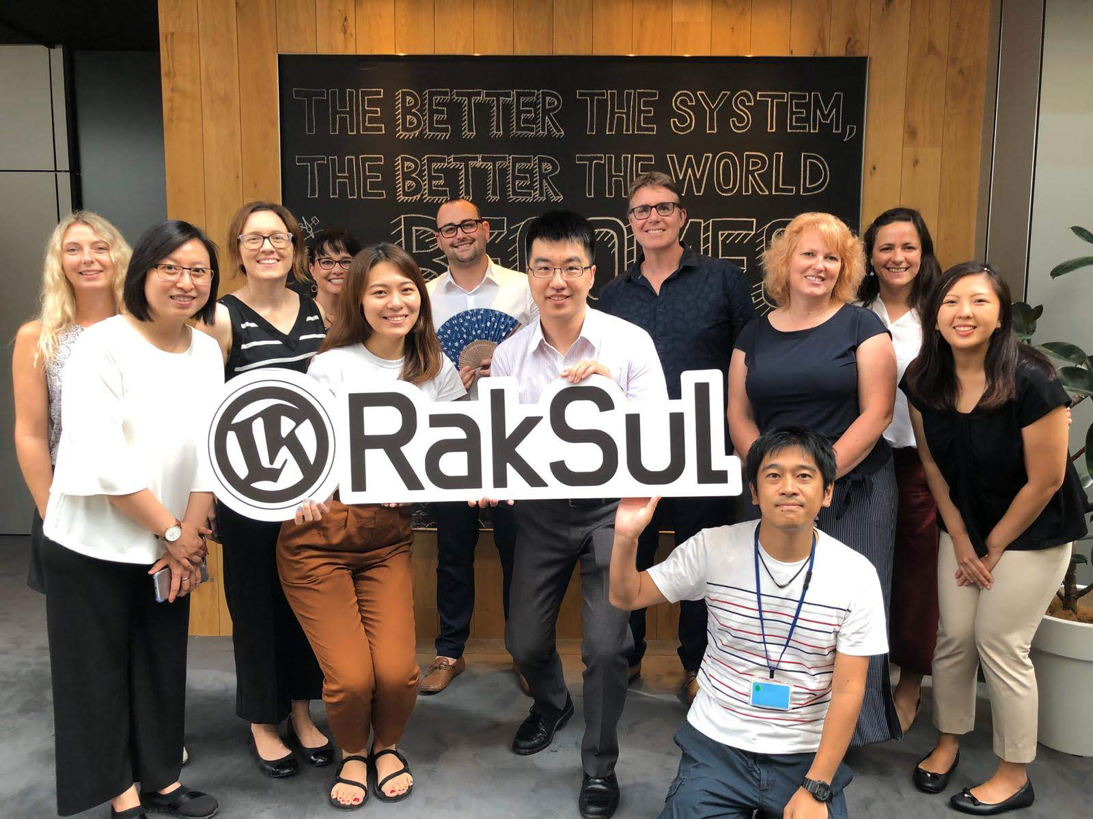
Virtual international internships
Guaranteed International Internship in your country of choice
Dedicated Career Coach
8 hours of Online Language Lessons
Access to CareerBridge – our Global Internship Curriculum
Weekly Group Discussions or Business Webinars
Full End of Program Report
*Sample of the actual internship company

Slide 9
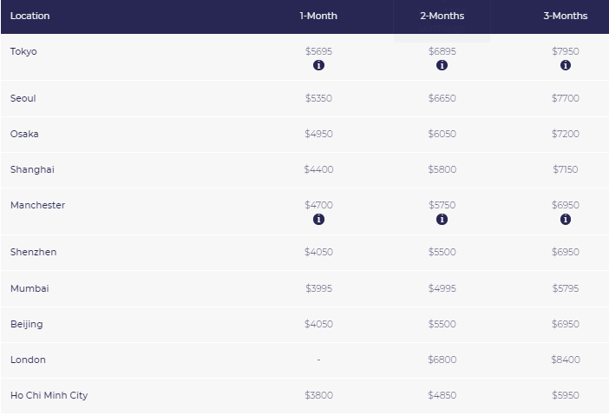
Fees for In-Country Internships

Slide 10
Fees-virtual internship

Slide 11
Any Questions?
If you have questions about these programs, please feel free to contact:
Jennifer Clevenger, Director of Global Study Abroad
email: jcleveng@vt.edu phone: 540.231.6602

